Slide 1
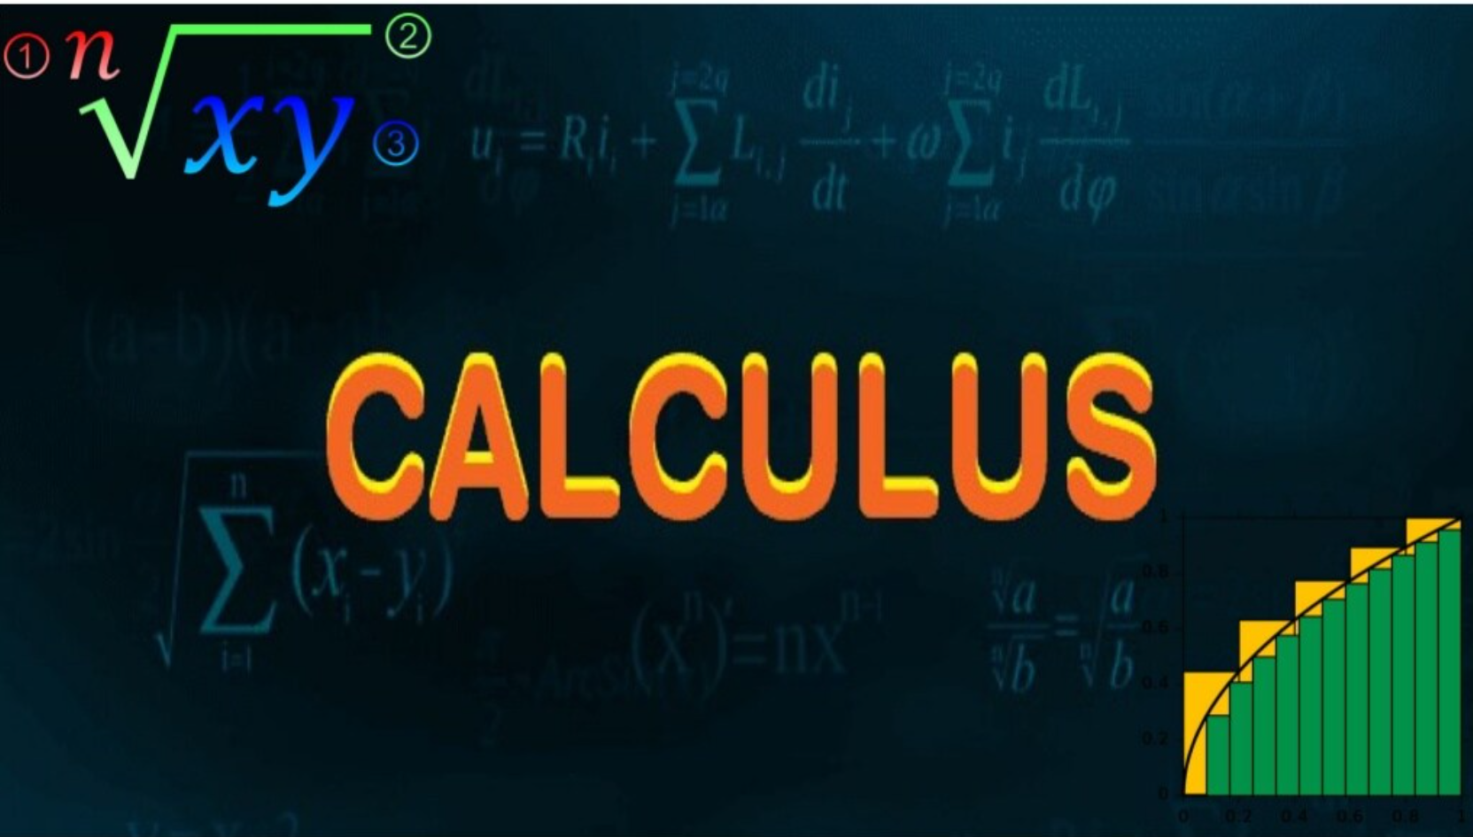

Slide 2
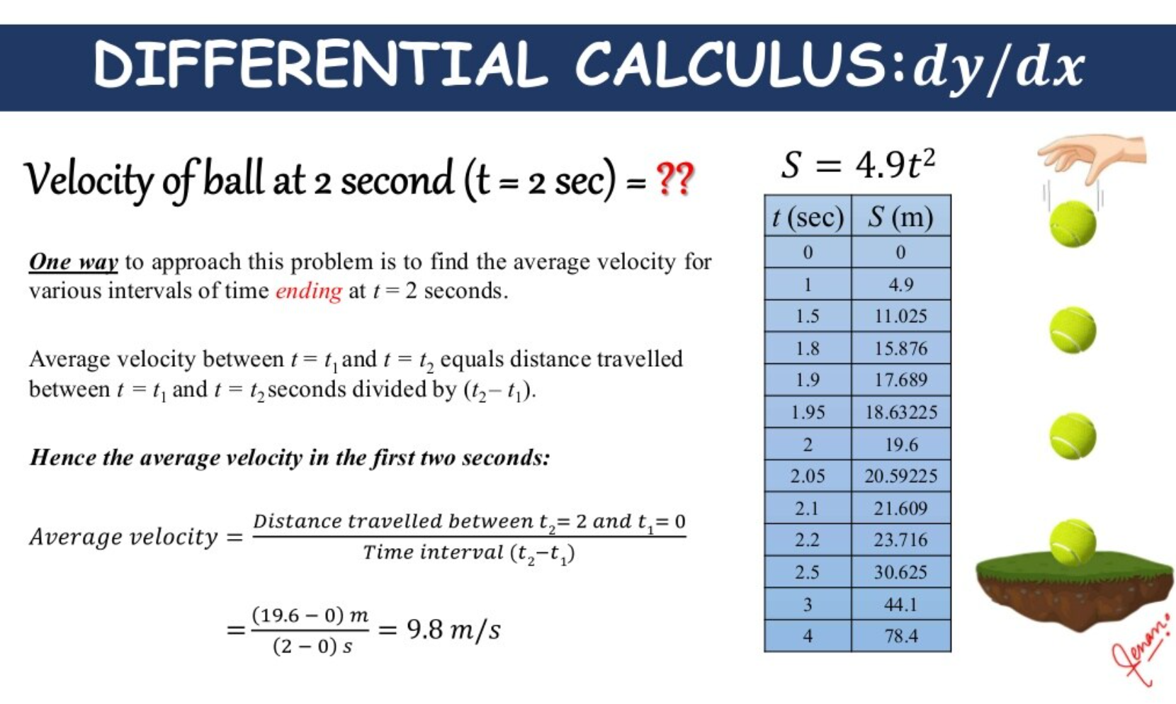

Slide 3
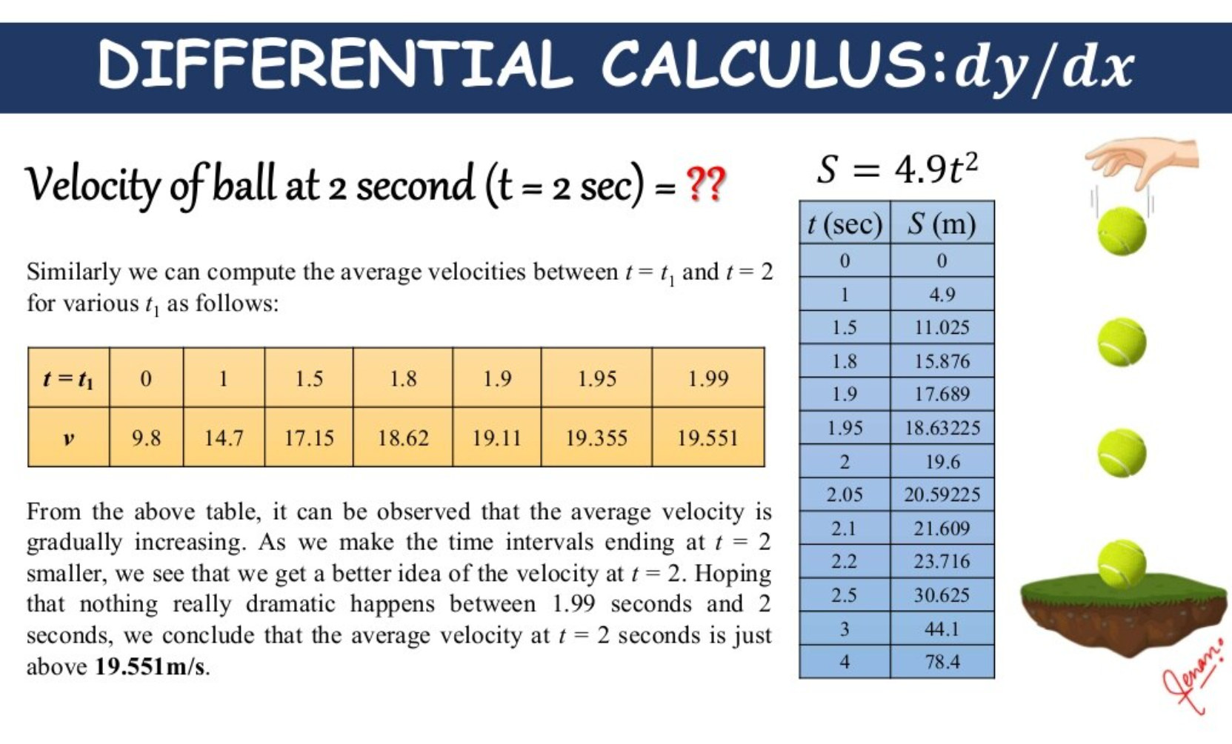

Slide 4


Slide 5
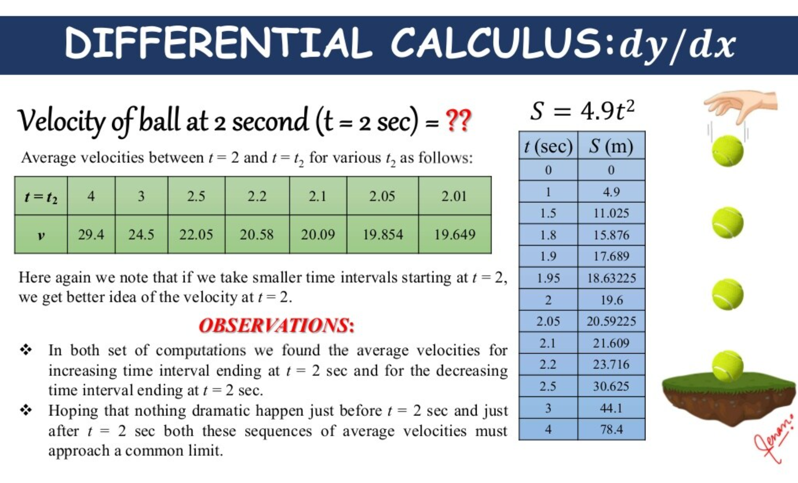

Slide 6
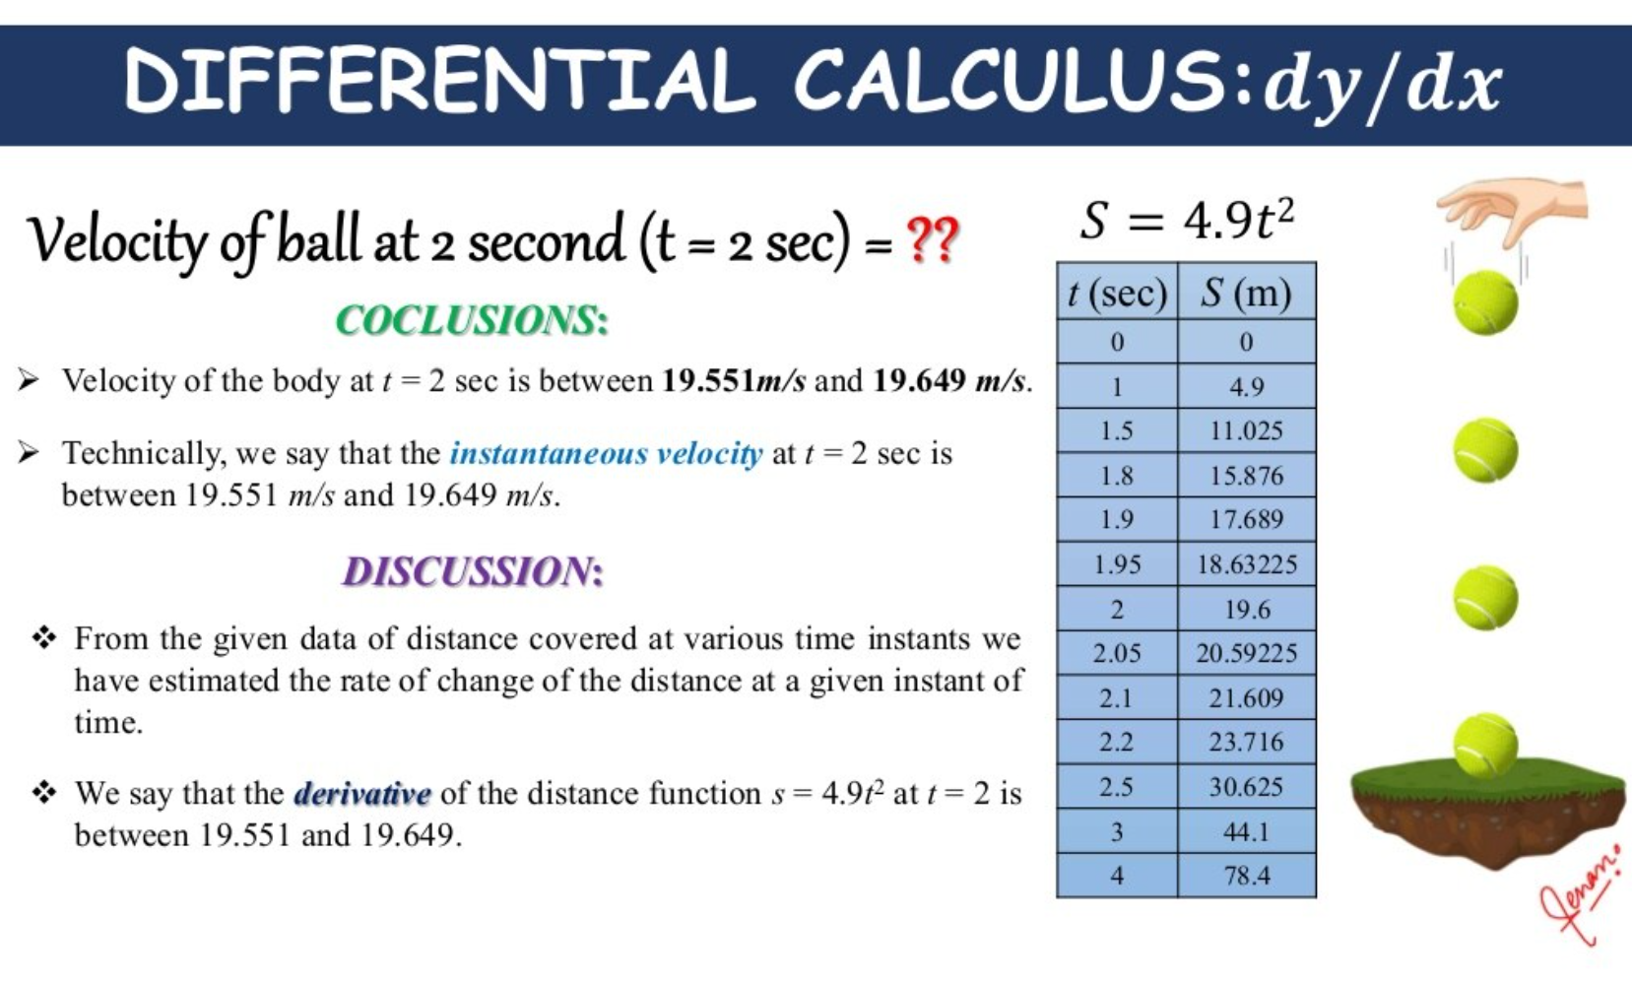

Slide 7
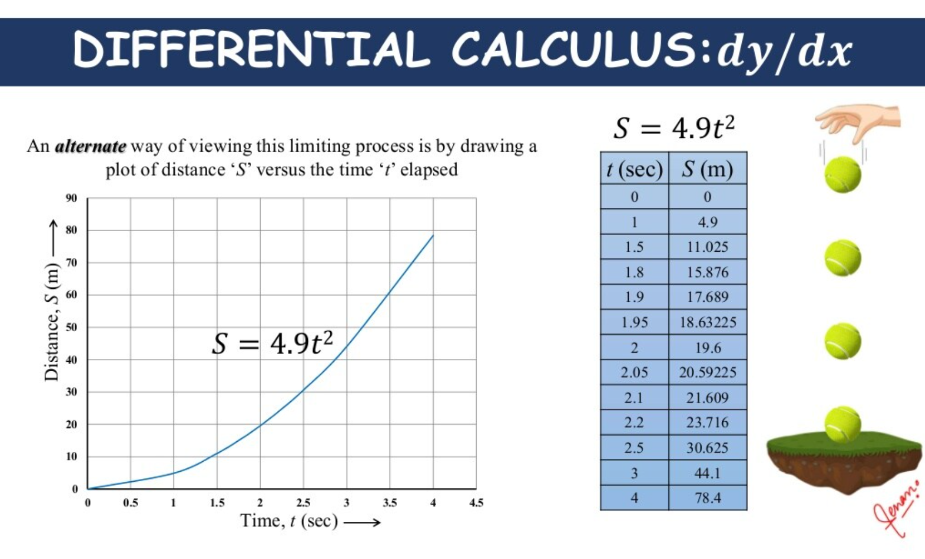

Slide 8
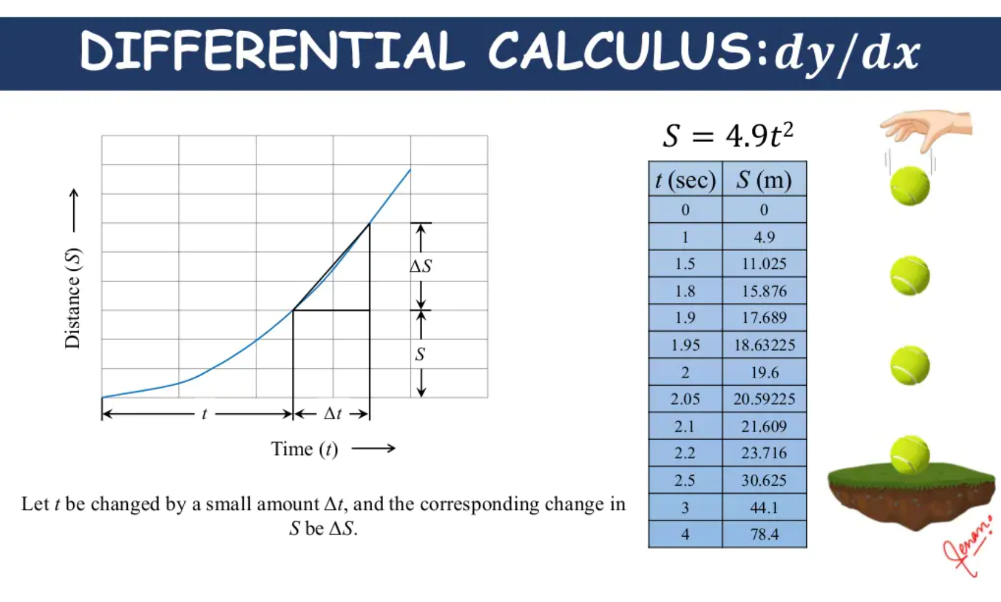

Slide 9
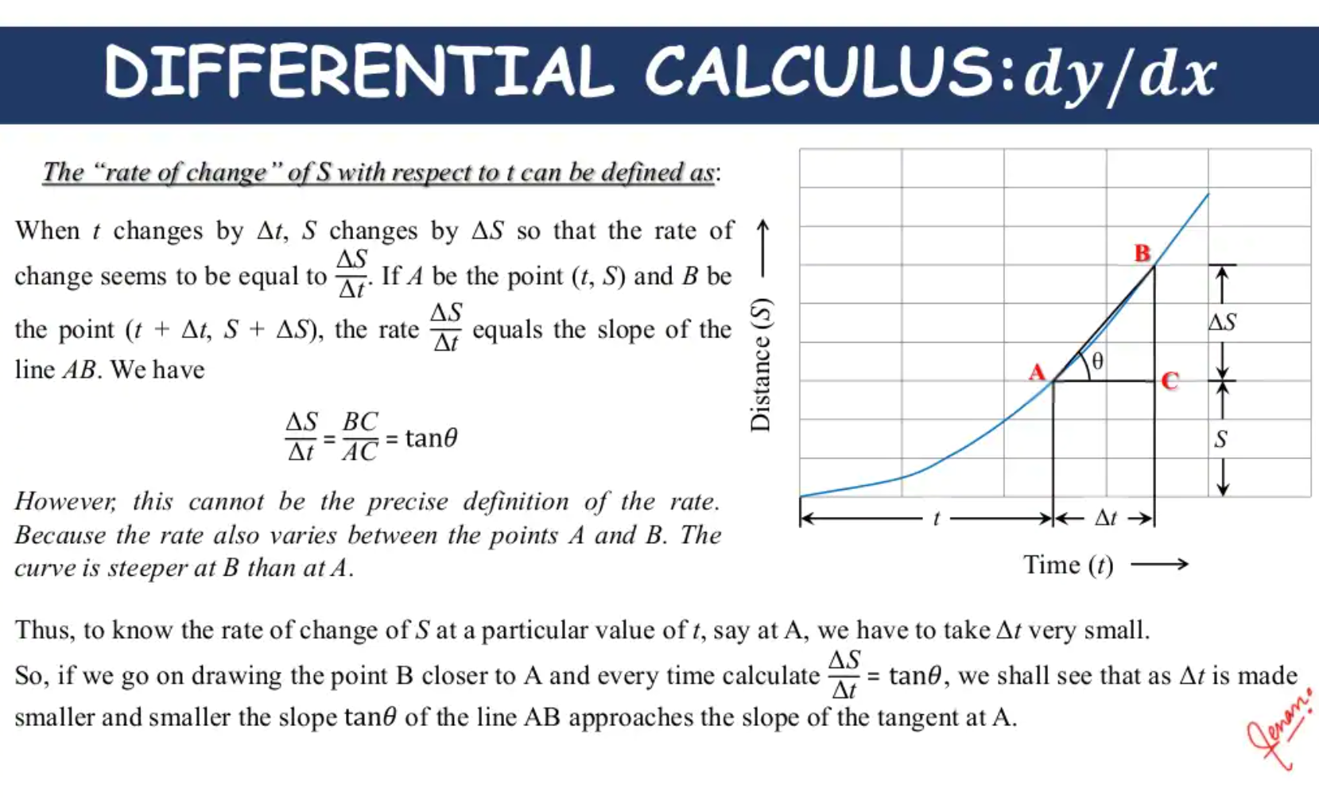

Slide 10
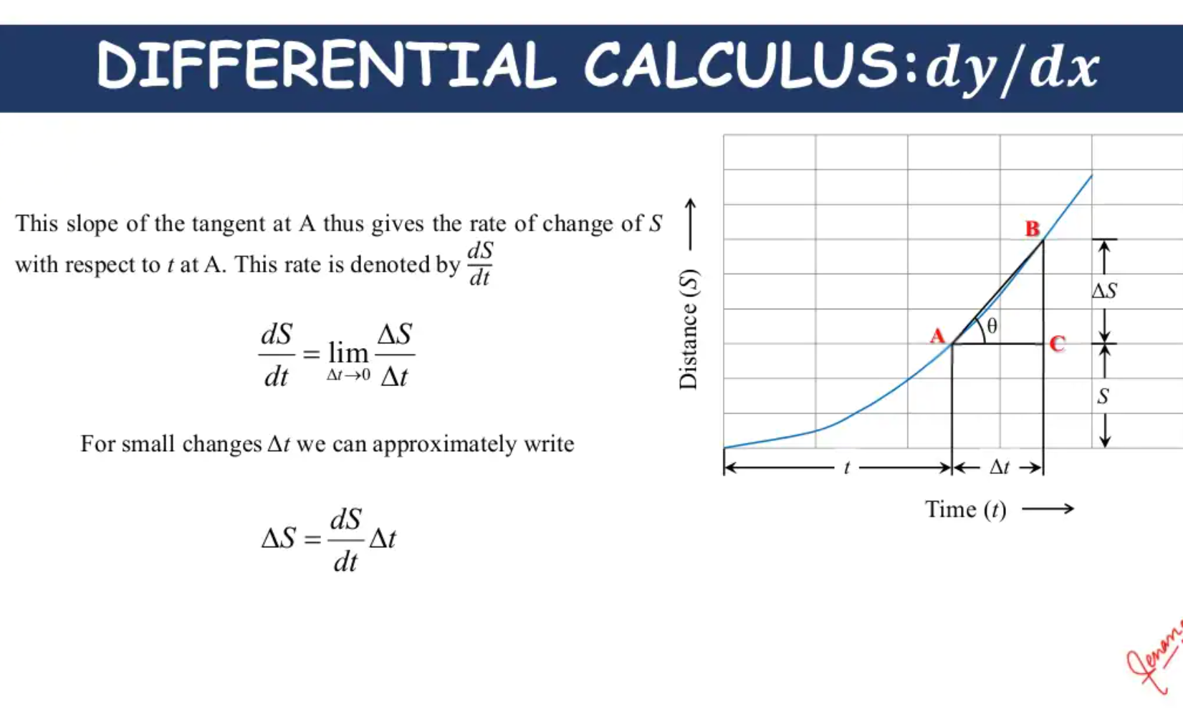

Slide 11
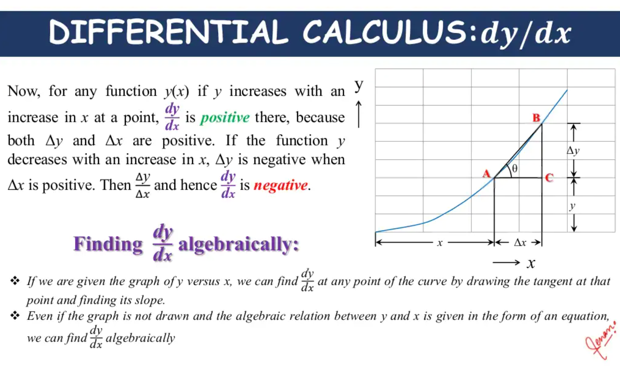

Slide 12
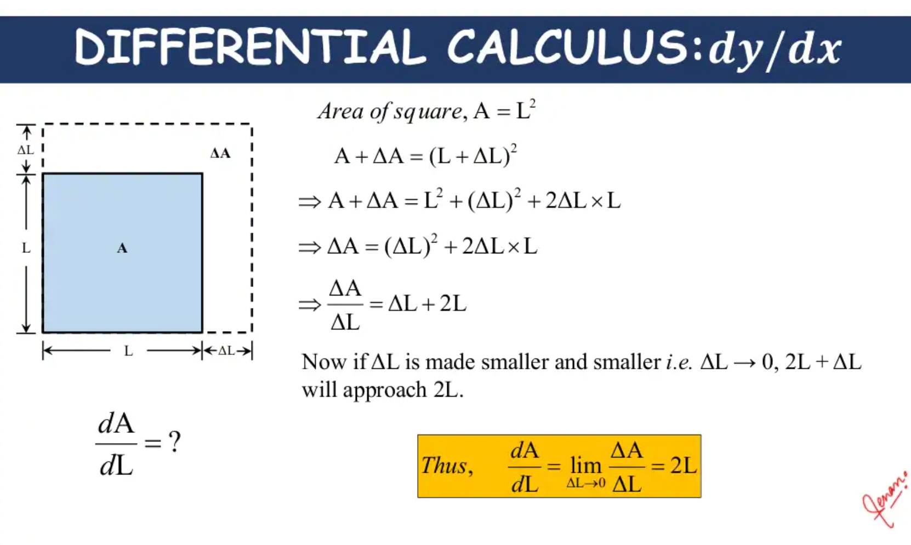

Slide 13
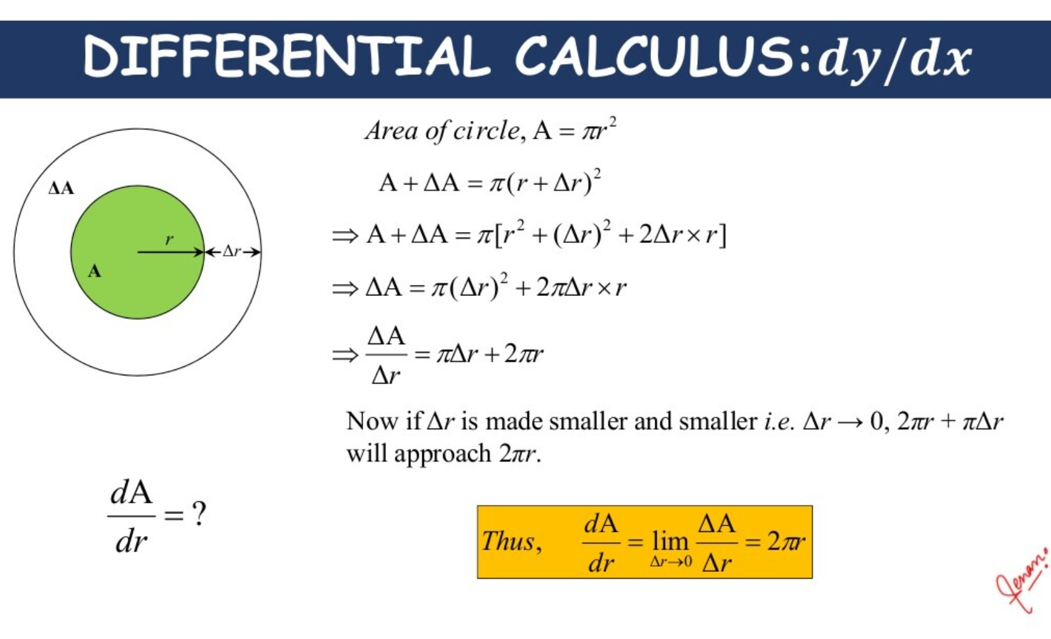

Slide 14
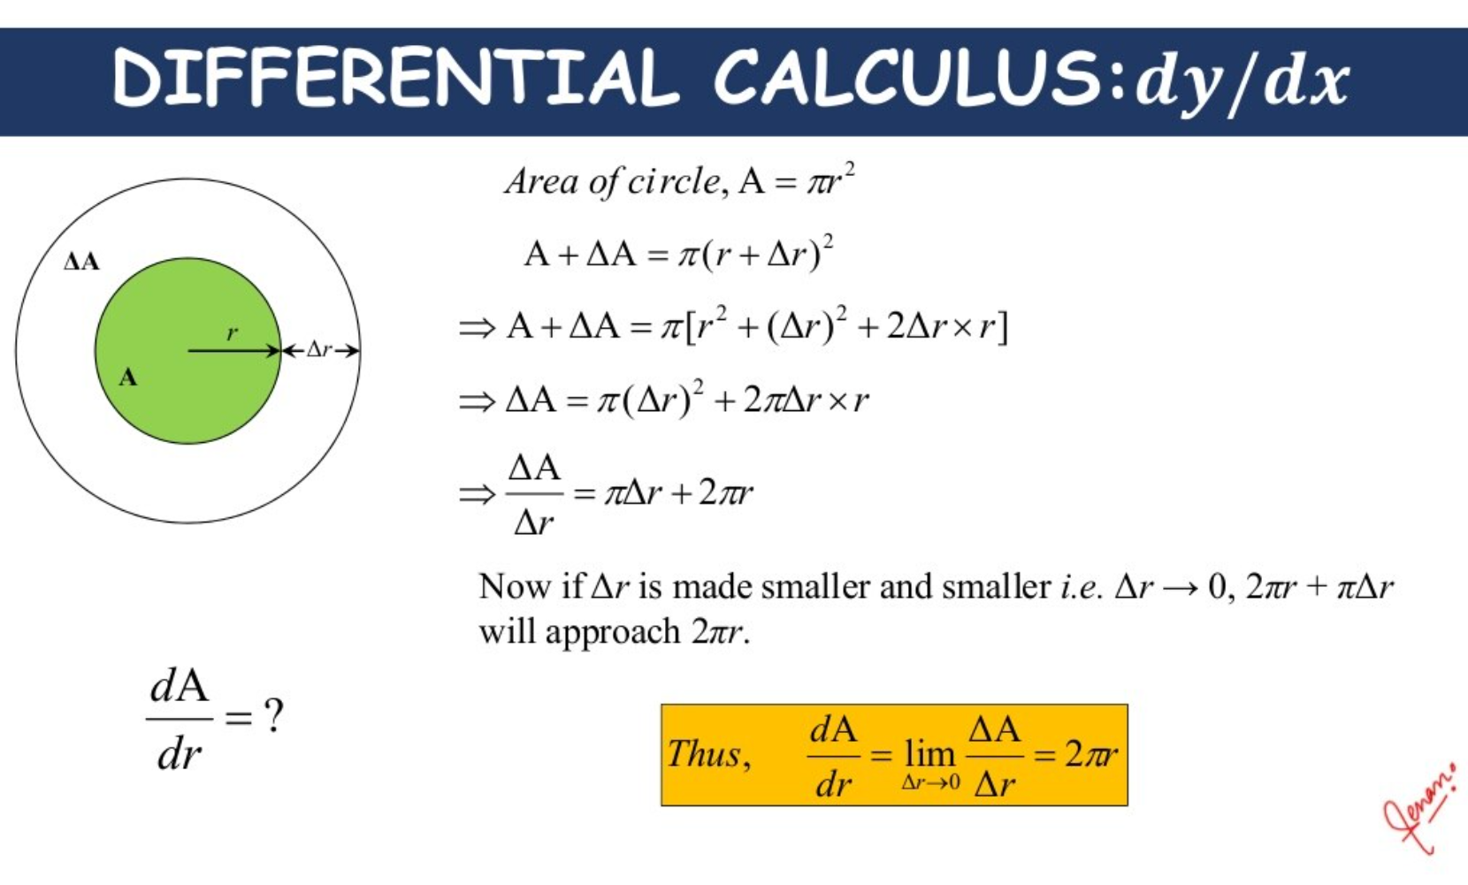

Slide 15
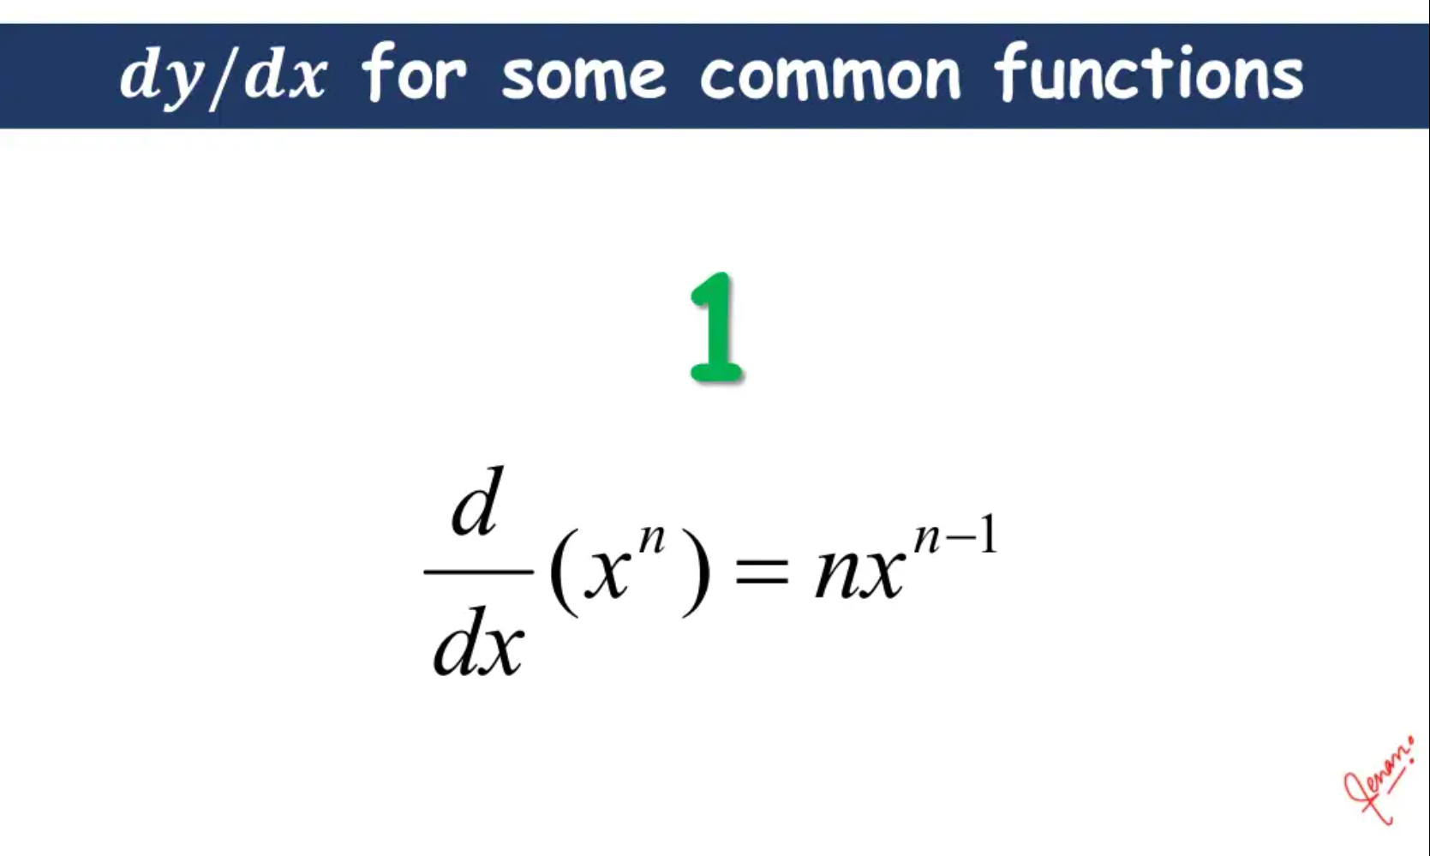

Slide 16
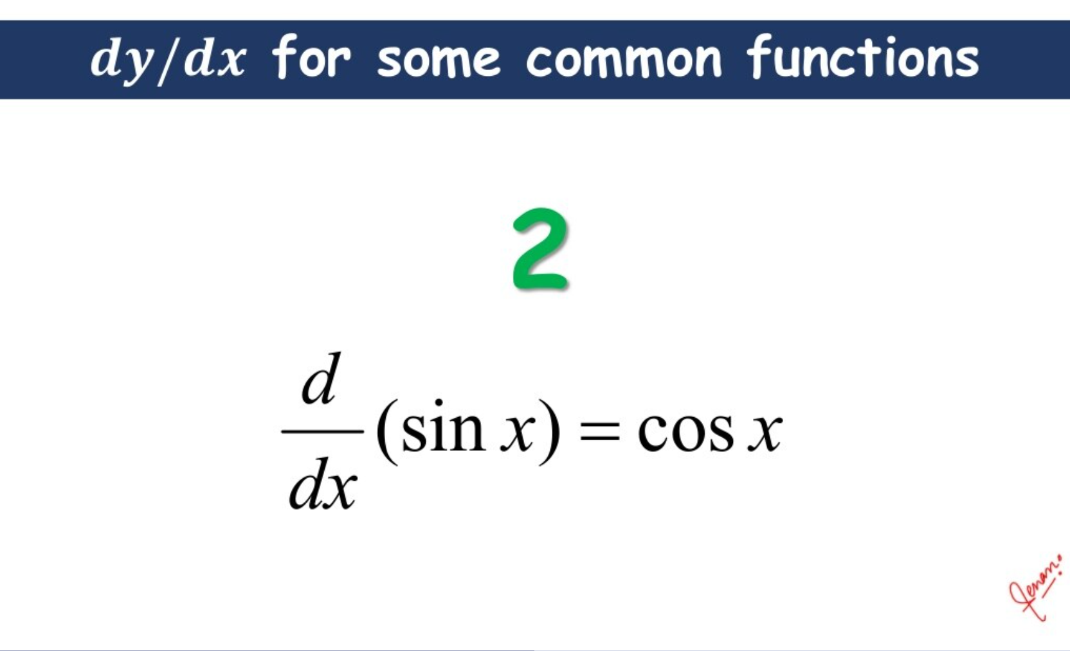

Slide 17
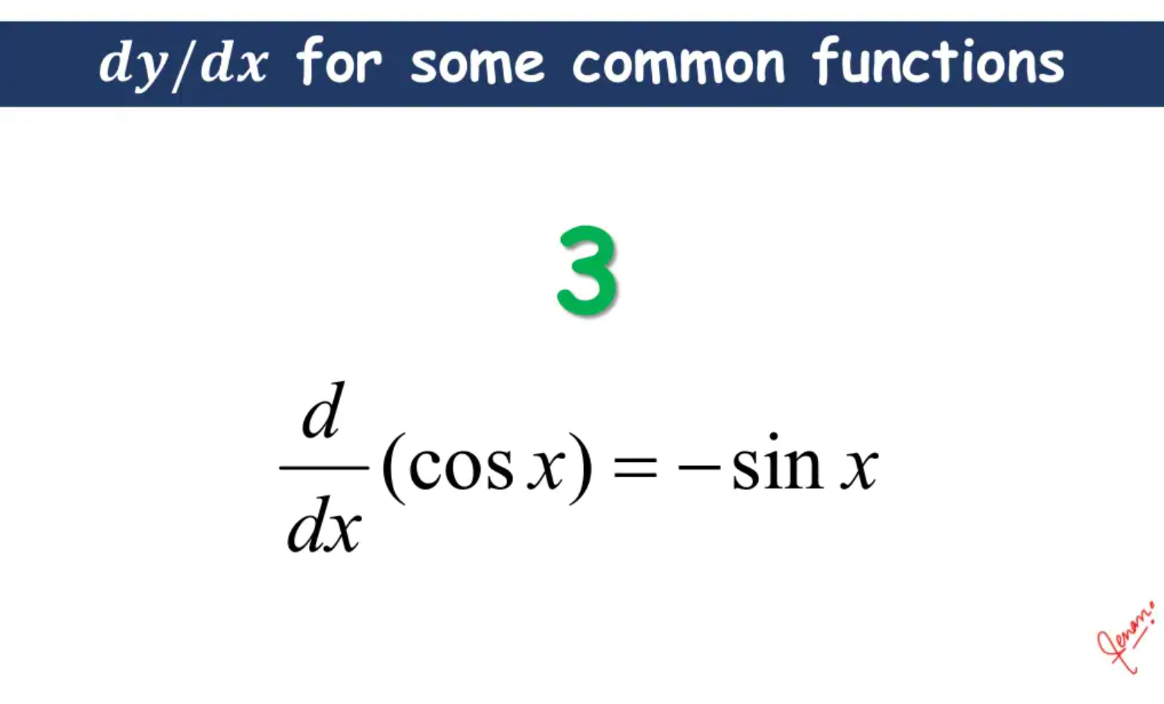

Slide 18
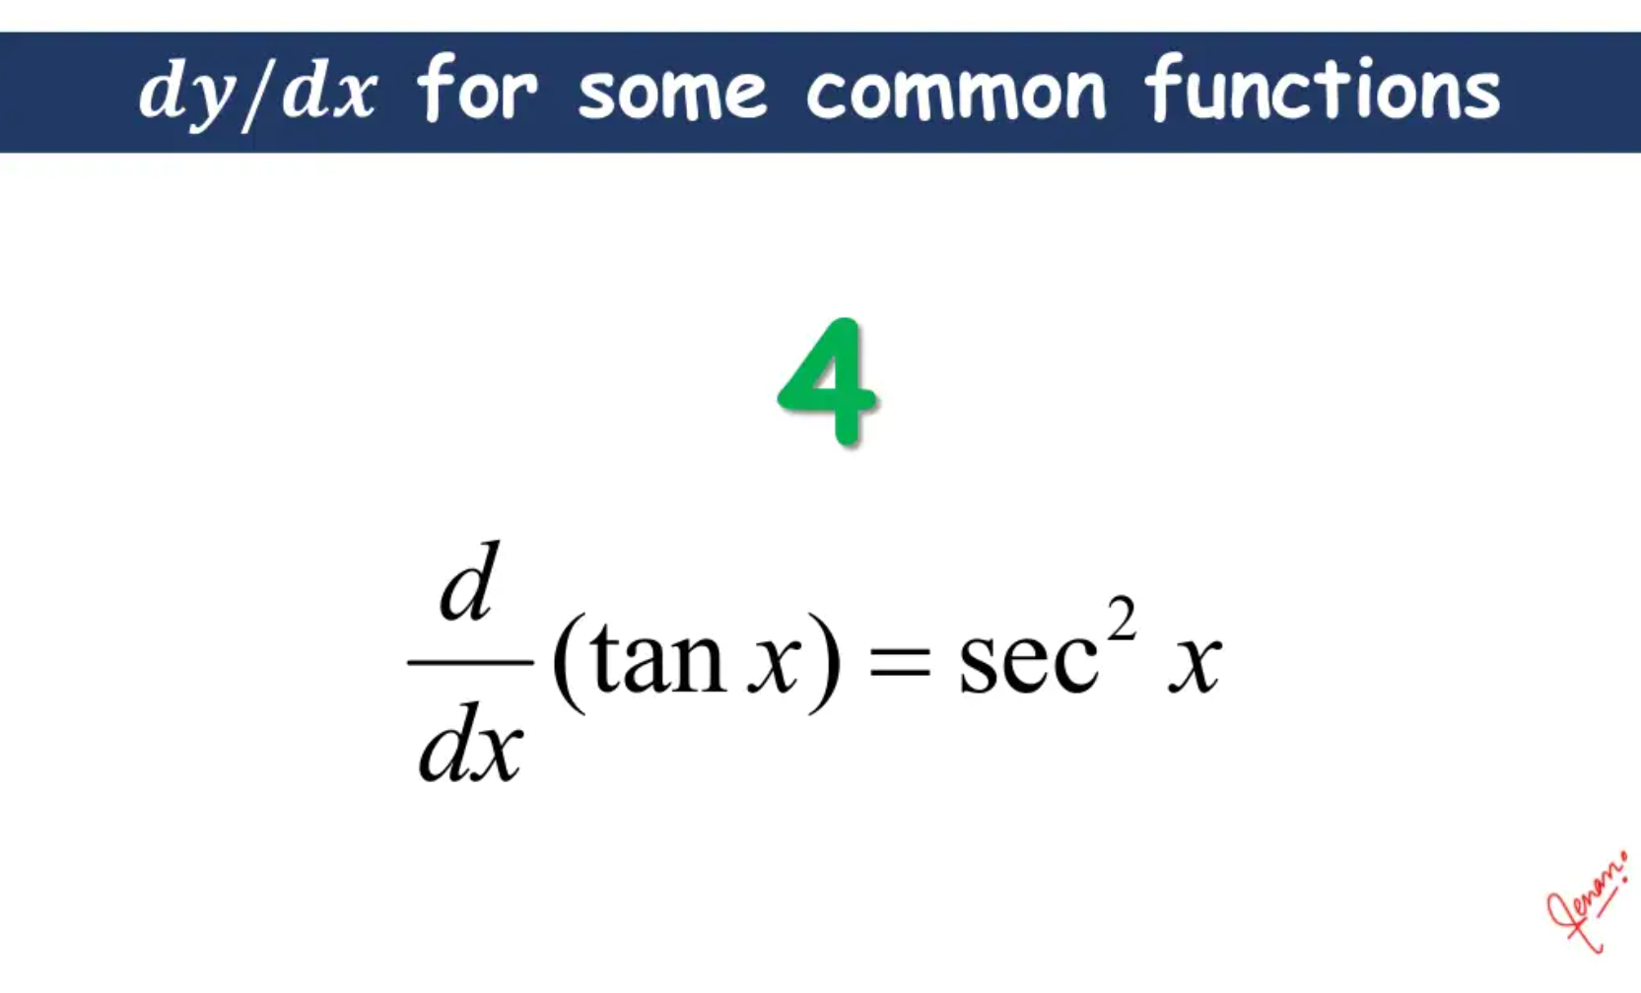

Slide 19
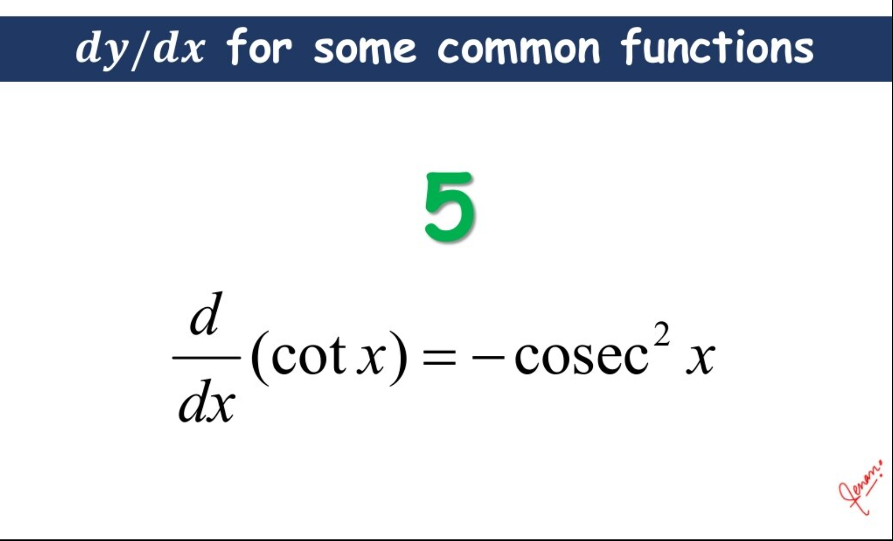

Slide 20
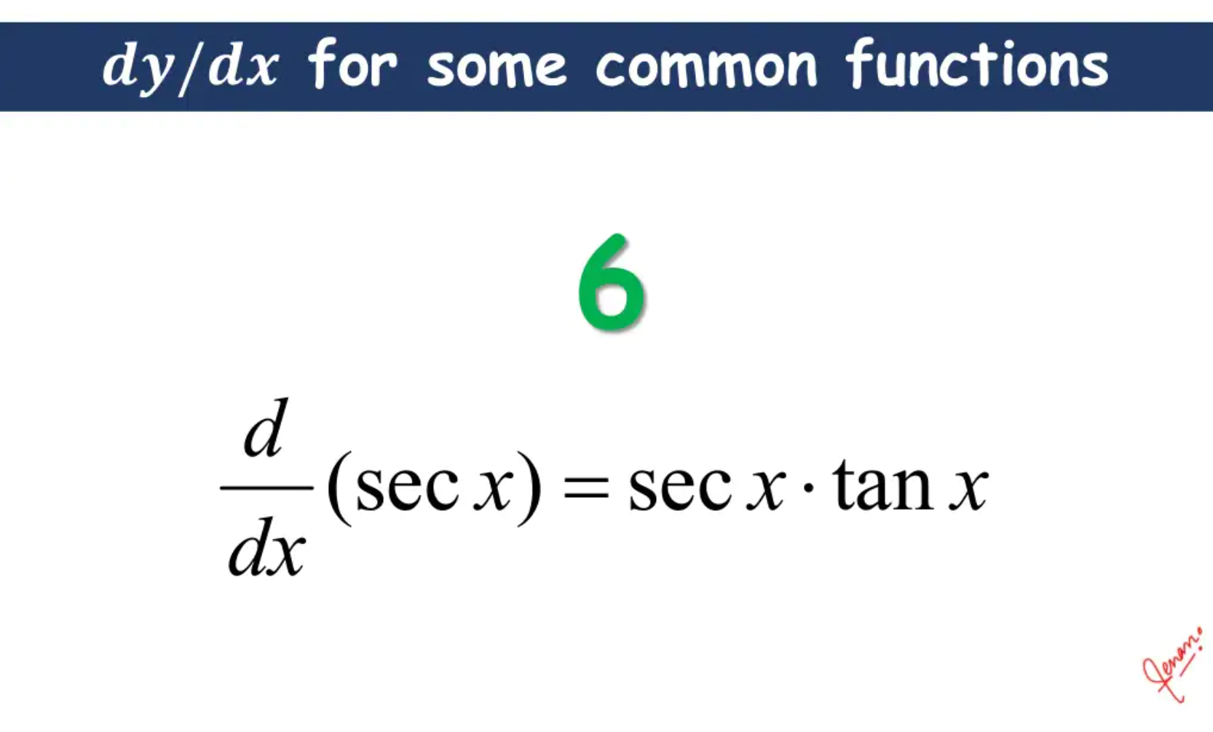

Slide 21
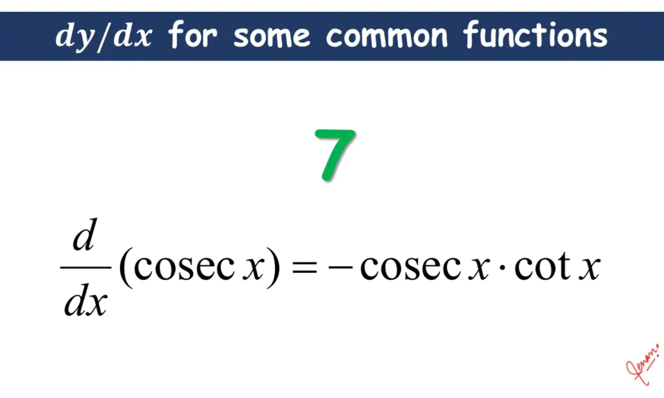

Slide 22
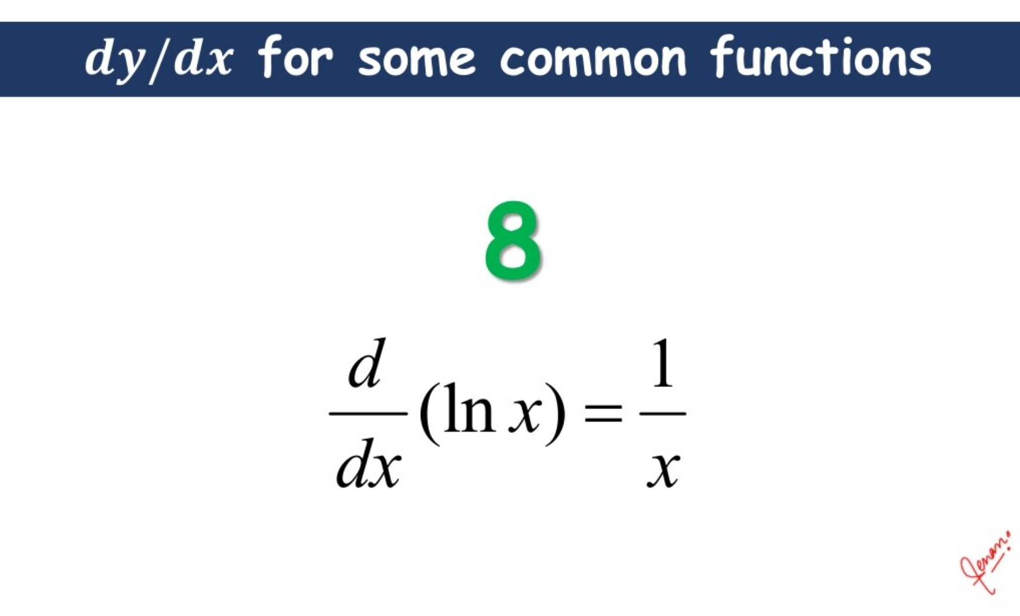

Slide 23
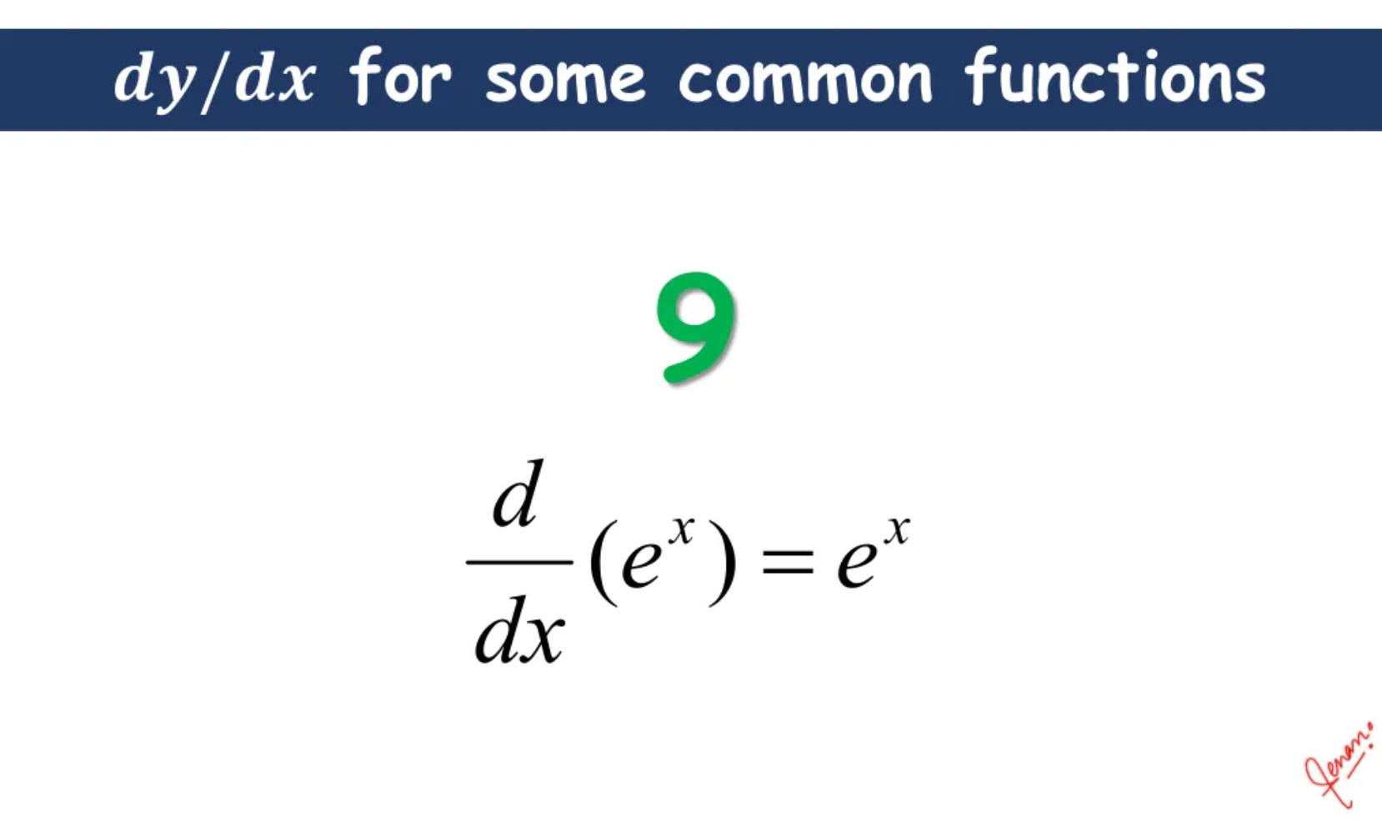

Slide 24
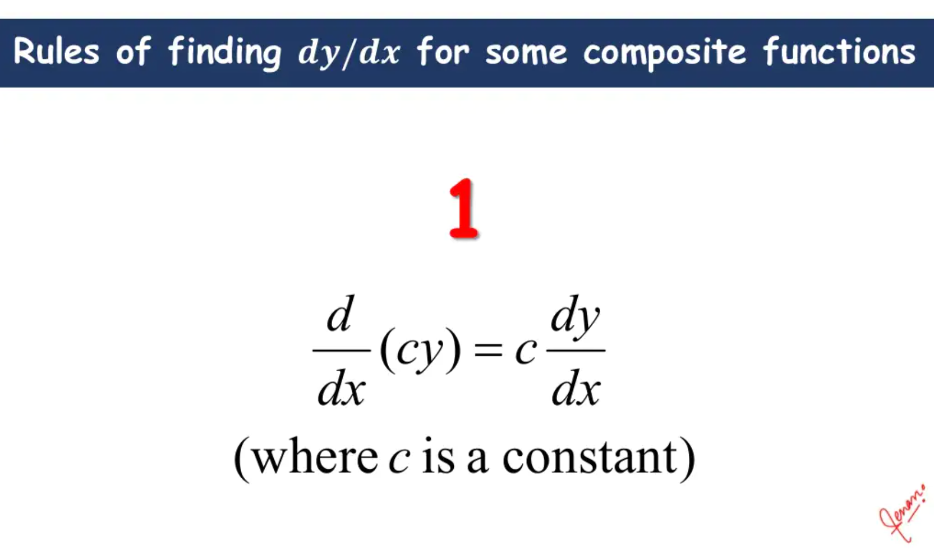

Slide 25
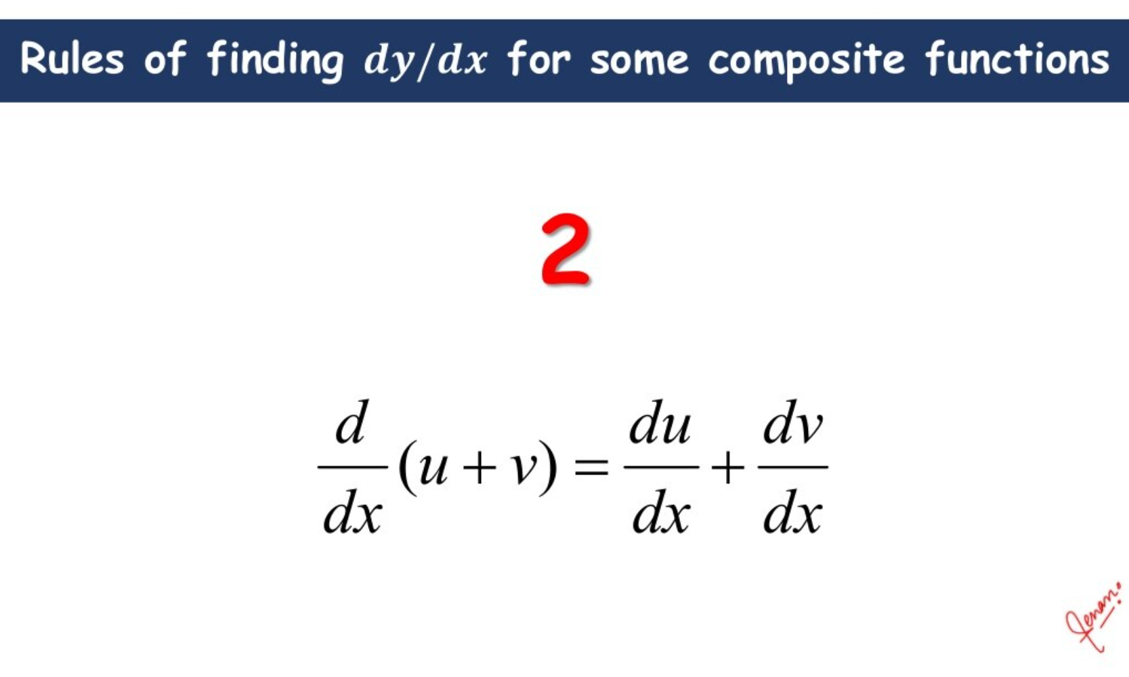

Slide 26
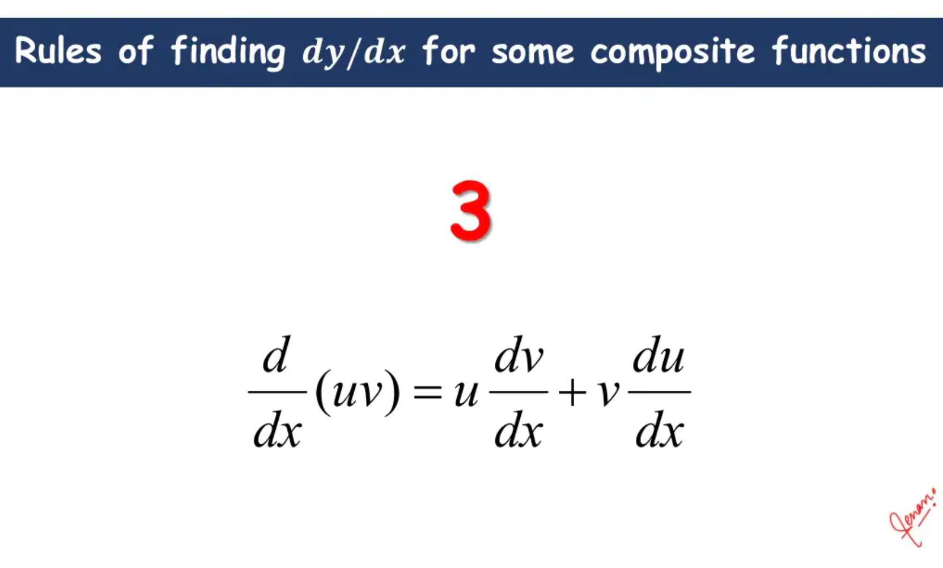

Slide 27
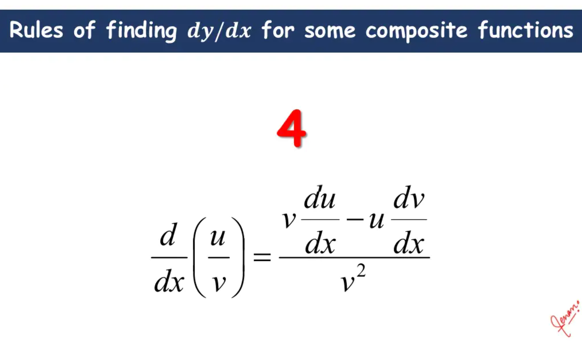

Slide 28
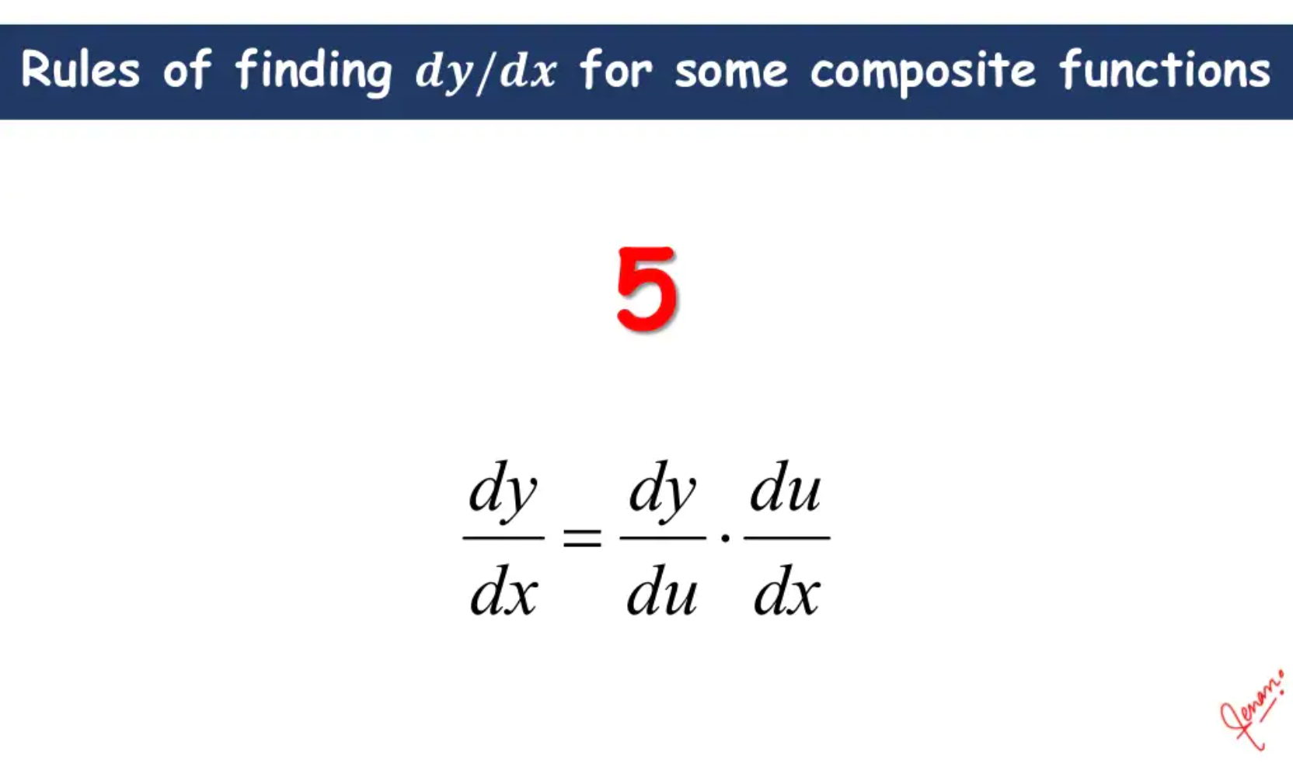

Slide 29
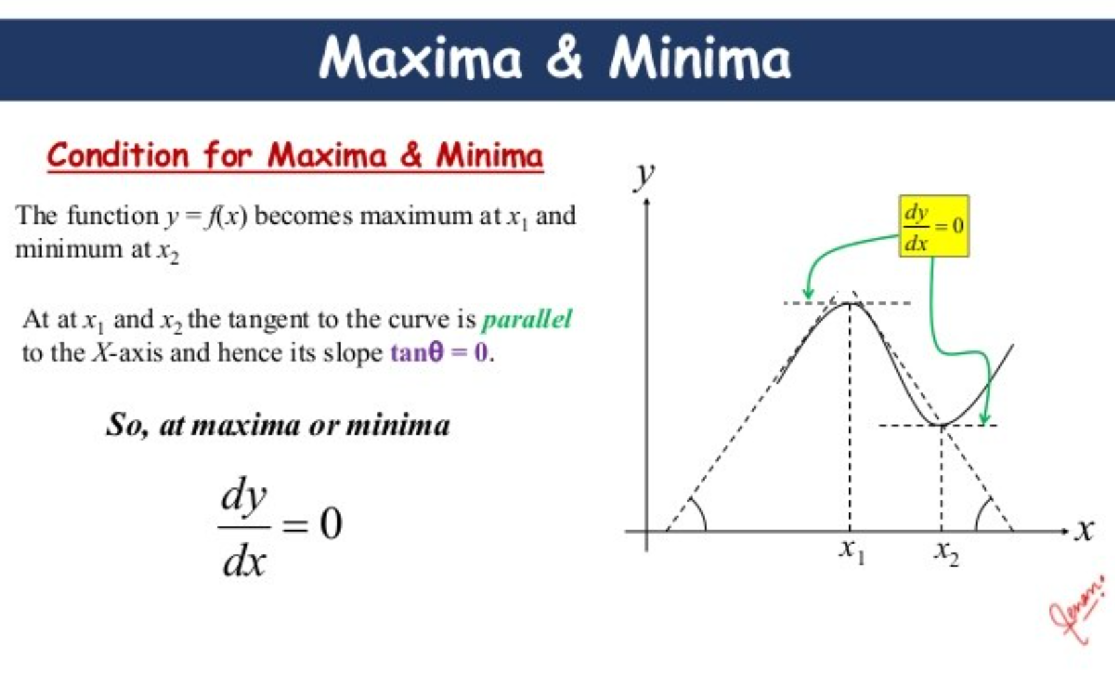

Slide 30
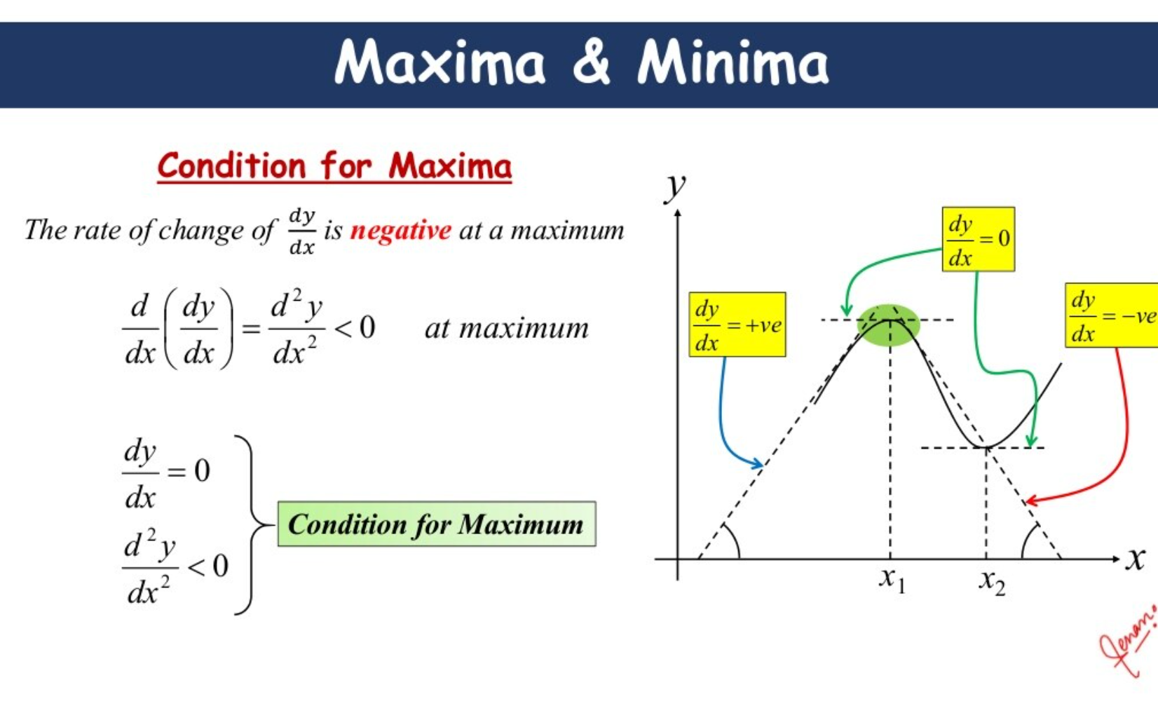

Slide 31
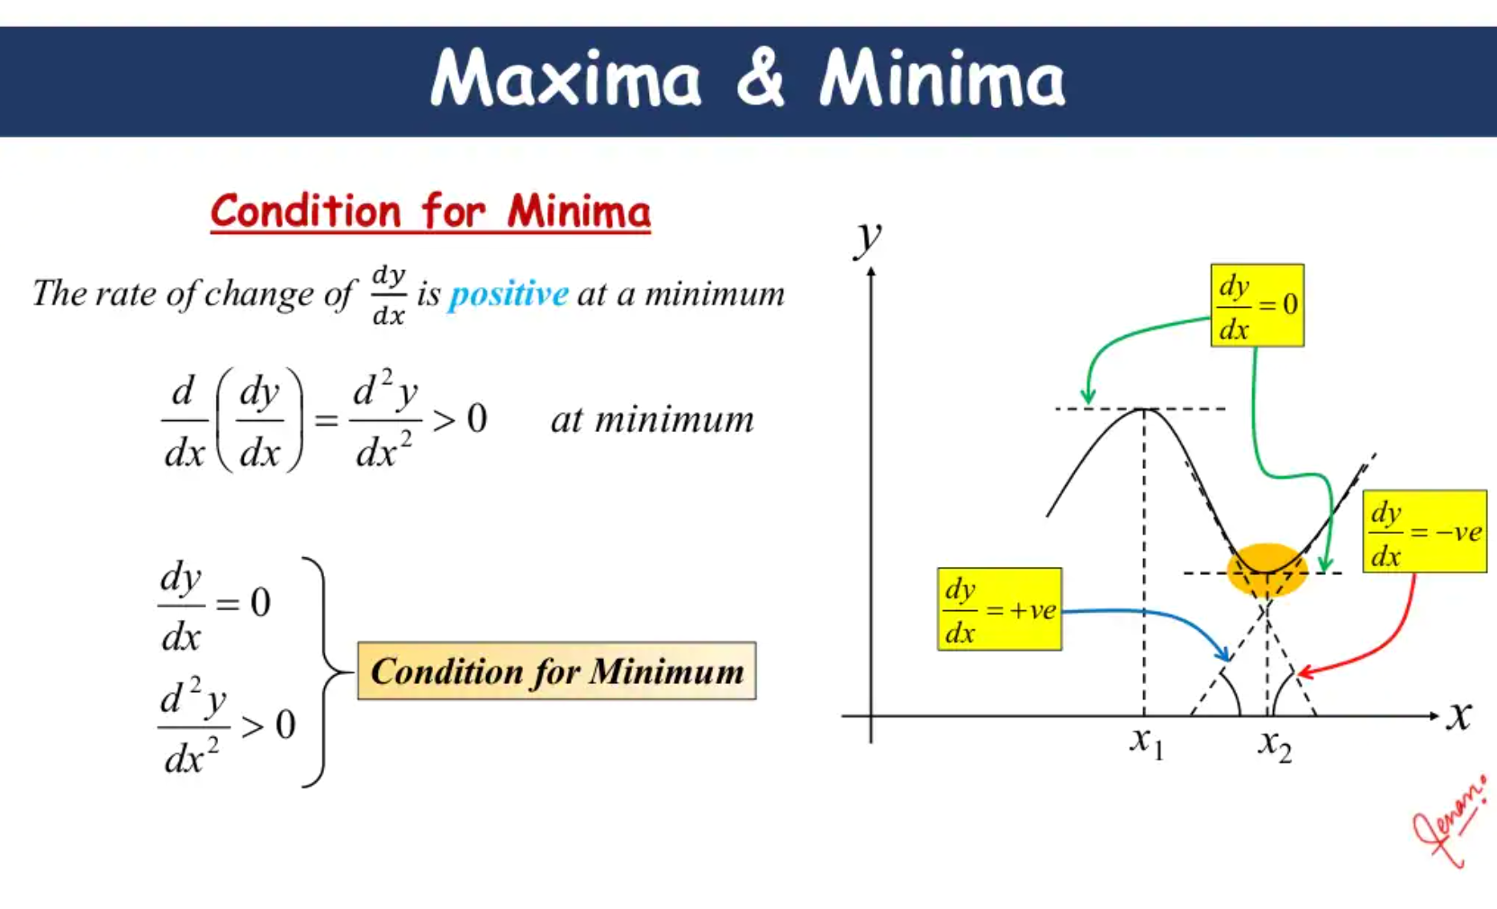

Slide 32
Differential Calculus and their Applications

Slide 33
Requirement Data
x₁ | x₂ | y
1 | 2 | 3
Let’s understand how Model will use input features (x₁, x₂) and learn to predict y

Slide 34
Hidden Layer
Input
Output
1
2
Using a simple neural network with 1 hidden layer

Slide 35
Hidden Layer
W₁₁₁ =0.5
Input
W₁₁₂ =0.3
Output
1
2
Let’s calculate output for 1st Neuron in hidden layer

Slide 36
h₁₁ = xW + b
W₁₁₁ =0.5
Input
W₁₁₂ =0.3
Output
1
2

Slide 37
h₁₁ = 1 * 0.5 + 2 * 0.3 + 1
W₁₁₁ =0.5
Input
W₁₁₂ =0.3
Output
1
2
Initializing each weight with random numbers and bias with 1 (can be any number)

Slide 38
h₁₁
2.1
W₁₁₁ =0.5
Input
W₁₁₂ =0.3
Output
1
2

Slide 39
h₁₁
2.1
o₁₁ = sigmoid(h₁₁)
W₁₁₁ =0.5
Input
W₁₁₂ =0.3
Output
1
2
Apply activation (sigmoid) to Neuron’s output

Slide 40
h₁₁
2.1
o₁₁ = 0.89
W₁₁₁ =0.5
Input
W₁₁₂ =0.3
Output
1
2

Slide 41
h₁₁
2.1
o₁₁ = 0.89
W₁₁₁ = 0.5
Input
W₁₁₂ =0.3
h₂₁
Output
1
2
W₁₂₁ = 0.15
1.95
o₁₂ = 0.875
W₁₂₂ = 0.4
Repeat calculations for 2nd neuron...

Slide 42
h₁₁
2.1
o₁₁ = 0.89
W₁₁₁ = 0.5
Input
W₁₁₂ =0.3
h₂₁
Output
1
2
W₁₂₁ = 0.15
1.95
o₁₂ = 0.875
W₁₂₂ = 0.4
W₁₃₁ = 0.65
h₁₃
1.05
W₁₃₂ = -0.3
o₁₃ = 0.741
...and 3rd Neuron

Slide 43
h₁₁
2.1
o₁₁ = 0.89
W₁₁₁ = 0.5
W₁₁₂ =0.3
Output = 0.89* -0.23 + 0.875 * 0.83 + 0.741 * -0.56 + 1
Input
h₂₁
W₂₁₁ = -0.23
1
2
W₁₂₁ = 0.15
1.95
o₁₂ = 0.875
W₂₁₂ = 0.83
W₁₂₂ = 0.4
W₂₁₃ = -0.56
W₁₃₁ = 0.65
h₁₃
1.05
W₁₃₂ = -0.3
o₁₃ = 0.741
Initialize weights and bias for output layer and calculate output

Slide 44
h₁₁
2.1
o₁₁ = 0.89
W₁₁₁ = 0.5
Input
W₁₁₂ =0.3
h₂₁
W₂₁₁ = -0.23
Output
1
2
W₁₂₁ = 0.15
1.95
o₁₂ = 0.875
W₂₁₂ = 0.83
1.106
W₁₂₂ = 0.4
W₂₁₃ = -0.56
W₁₃₁ = 0.65
h₁₃
1.05
W₁₃₂ = -0.3
o₁₃ = 0.741
What’s next?

Slide 45
h₁₁
2.1
o₁₁ = 0.89
W₁₁₁ = 0.5
Input
W₁₁₂ =0.3
h₂₁
W₂₁₁ = -0.23
Output
1
2
Loss
W₁₂₁ = 0.15
1.95
o₁₂ = 0.875
W₂₁₂ = 0.83
1.106
(Prediction - Actual)²/2
W₁₂₂ = 0.4
W₂₁₃ = -0.56
W₁₃₁ = 0.65
h₁₃
1.05
W₁₃₂ = -0.3
o₁₃ = 0.741
Calculate Loss

Slide 46
h₁₁
2.1
o₁₁ = 0.89
W₁₁₁ = 0.5
Input
W₁₁₂ =0.3
h₂₁
W₂₁₁ = -0.23
Output
1
2
Loss
W₁₂₁ = 0.15
1.95
o₁₂ = 0.875
W₂₁₂ = 0.83
1.106
(1.106 - 3)²/2
= 1.793
W₁₂₂ = 0.4
W₂₁₃ = -0.56
W₁₃₁ = 0.65
h₁₃
1.05
W₁₃₂ = -0.3
o₁₃ = 0.741
Forward Propagation i.e starting with Input features, calculate Loss

Slide 47

How do we update weights?

Slide 48
h₁₁
2.1
o₁₁ = 0.89
W₁₁₁ = 0.5
Input
W₁₁₂ =0.3
h₂₁
W₂₁₁ = -0.23
Output
1
2
Loss
W₁₂₁ = 0.15
1.95
o₁₂ = 0.875
W₂₁₂ = 0.83
1.106
1.793
W₁₂₂ = 0.4
W₂₁₃ = -0.56
W₁₃₁ = 0.65
h₁₃
1.05
W₁₃₂ = -0.3
o₁₃ = 0.741
Minimizing Loss using Gradient Descent

Slide 49
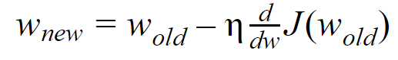
Gradient Descent
Calculate Gradient for Loss w.r.t each Weight and Bias in the Neural Network

Slide 50
h₁₁
2.1
o₁₁ = 0.89
W₁₁₁ = 0.5
Input
W₁₁₂ =0.3
h₂₁
W₂₁₁ = -0.23
Output
1
2
Loss
W₁₂₁ = 0.15
1.95
o₁₂ = 0.875
W₂₁₂ = 0.83
1.106
1.793
W₁₂₂ = 0.4
W₂₁₃ = -0.56
W₁₃₁ = 0.65
h₁₃
1.05
W₁₃₂ = -0.3
o₁₃ = 0.741
We start with Weights nearest to Output Layer e.g. W₂₁₁

Slide 51
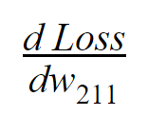
How is Loss related to w₂₁₁?

Slide 52
h₁₁
2.1
o₁₁ = 0.89
W₁₁₁ = 0.5
Input
W₁₁₂ =0.3
h₂₁
W₂₁₁ = -0.23
Output
1
2
Loss
W₁₂₁ = 0.15
1.95
o₁₂ = 0.875
W₂₁₂ = 0.83
1.106
1.793
W₁₂₂ = 0.4
W₂₁₃ = -0.56
W₁₃₁ = 0.65
h₁₃
1.05
W₁₃₂ = -0.3
o₁₃ = 0.741
Loss is dependent on Output, Output is dependent on W₂₁₁

Slide 53
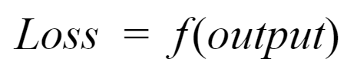
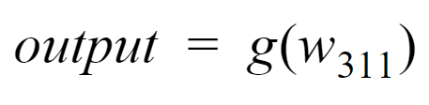
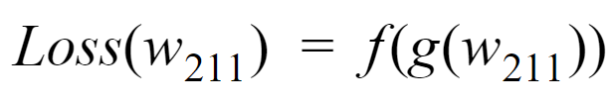

Slide 54
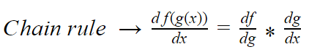
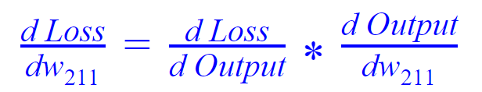
Let’s calculate each Gradient term individually

Slide 55
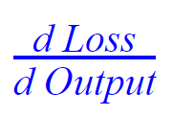
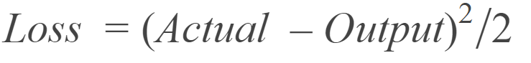
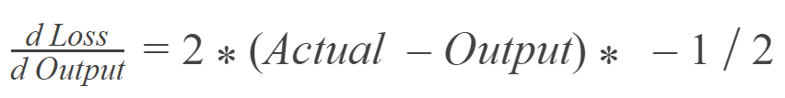
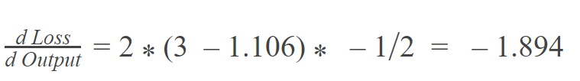

Slide 56
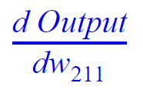
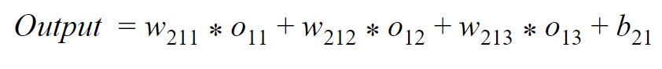
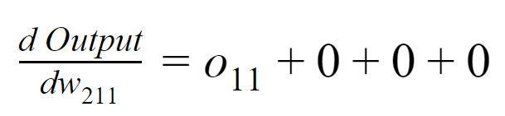
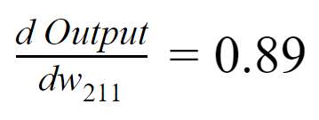

Slide 57
-1.894 * 0.89
= -1.686
What will be new value of w₂₁₁?

Slide 58
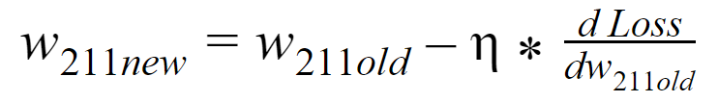
Learning rate (assume 0.01 here)
= -0.23 - 0.01 * -1.686
= -0.213

Slide 59
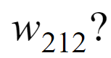
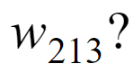
Calculate both in same way as W₂₁₁

Slide 60
h₁₁
2.1
o₁₁ = 0.89
W₁₁₁ = 0.5
Input
W₁₁₂ =0.3
h₂₁
W₂₁₁ = -0.23
Output
1
2
Loss
W₁₂₁ = 0.15
1.95
o₁₂ = 0.875
W₂₁₂ = 0.83
1.106
1.793
W₁₂₂ = 0.4
W₂₁₃ = -0.56
W₁₃₁ = 0.65
h₁₃
1.05
W₁₃₂ = -0.3
o₁₃ = 0.741
Updating weight for hidden layer e.g W₁₁₁

Slide 61
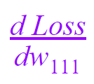
How is Loss related to w₁₁₁?

Slide 62
h₁₁
2.1
o₁₁ = 0.89
W₁₁₁ = 0.5
Input
W₁₁₂ =0.3
h₂₁
W₂₁₁ = -0.23
Output
1
2
Loss
W₁₂₁ = 0.15
1.95
o₁₂ = 0.875
W₂₁₂ = 0.83
1.106
1.793
W₁₂₂ = 0.4
W₂₁₃ = -0.56
W₁₃₁ = 0.65
h₁₃
1.05
W₁₃₂ = -0.3
o₁₃ = 0.741
W₁₁₁ → h₁₁ → o₁₁ → Output → Loss

Slide 63
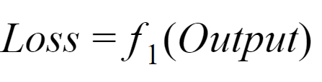




Slide 64

Using Chain Rule
Already calculated while calculating Gradient for Weights in Output Layer

Slide 65



Gradient in Hidden Layer is dependent on Weights in Next Layers
-0.23

Slide 66



Activation (Sigmoid) function
NOTE!
Activation function should be Differentiable i.e it should be possible to calculate partial derivative of Activation function
0.89*(1-0.89)
=0.0979

Slide 67



1

Slide 68
-1.894 * -0.23 * 0.0979 * 1
= 0.0426

Slide 69
New value of w₁₁₁
= 0.5 - 0.01 * 0.0426
= 0.499
Calculate Gradients and perform Descent for other Weights in Hidden layer

